Slide 1
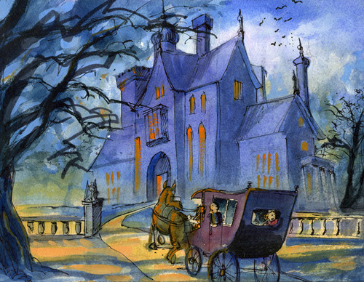
“The Canterville Ghost” chapter 2
Liceo Nuestra Señora María Inmaculada del Bosque
English Department 3°grade
Aim: to demonstrate comprehension of written and oral texts. Identify key vocabulary and remember previous chapter.

Slide 2
Do you remember what happened in the first chapter?
The Otis family met the ghost
The Otis family celebrated a party
The Otis family arrived to the mansion
Remember that…
They met Lord Canterville and Mrs Umney.
They were warned about the ghost.
And at the last minute a storm surprised them.

Slide 3
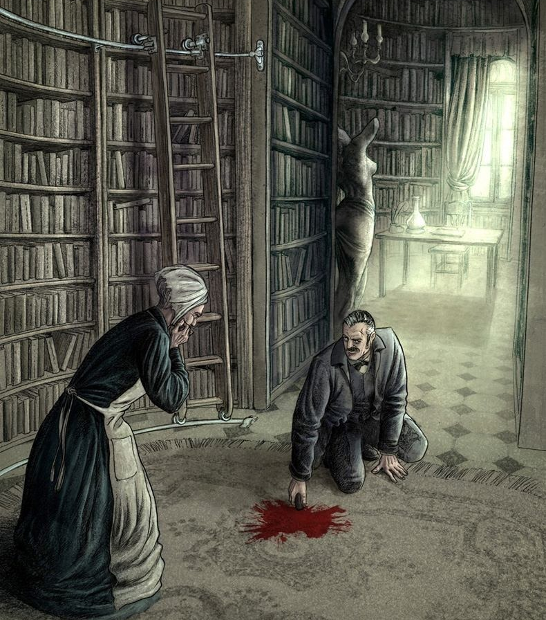
Exercise 1: Match the sentences from part A to part B and write them on your copybook.
Column A Column B
1) Mister Otis was a …. A) Always appeared before the death of someone of the family.
2) The ghost … B) The housekeeper
3) Washington was… C) it needed to be cleaned more than once.
4) Mrs Umney was… D) Businessman
5) The bloodstain… E) Mr and Mrs Otis eldest son.

Slide 4
Pre-reading activity: Before you read Chapter 2, can you guess what happens? Choose answers to these questions.
1. What will the Otis family find the next morning?
A) The ghost has killed Mrs. Umney
B) The bloodstain is back on the library floor again.
C) All the books in the library are on the floor.
D) The ghost has broken the little black stick into pieces.
2. What will Mr. Otis do when he meets the ghost?
A) Tell him to leave.
B) Sit down and talk to him.
C) Give him a bottle of oil
D) Shoot him.

Slide 5
Vocabulary
Verbs
Nouns
Nouns
Noise:
Definition: A sound or sounds, especially when it is unwanted, unpleasant, or loud.
Translation: Ruido.
Footsteeps:
Definition: The sound made by a person walking as their foot touches the ground, or a step.
Translation: Pisadas.
Cupboard:
Definition: A recess or piece of furniture with a door and typically shelves, used for storage.
Translation: Armario.
Holes:
Definition: A hollow place in a solid body or surface.
Translation: Hoyos.
Knocked:
Definition: To repeatedly hit something, producing a noise.
Translation: Golpeó
Shot:
Definition: The firing of a gun or cannon.
Translation: Disparó.

Slide 6
footsteps
Cupboard
holes
noise

Slide 7
knocked
shot

Slide 8
Activity 3: Answer the following questions in your copybook
1) Do you really believe that Mr. Otis wanted to help the ghost? Why or why not?
2) Would you be afraid of a ghost? Why or why not?
3) Do you think the ghost will take revenge?

Slide 9
Quiz n°2 (Chapters 1-2)
Don´t forget to answer the quiz
The link will be available in school’s web page.

Slide 10
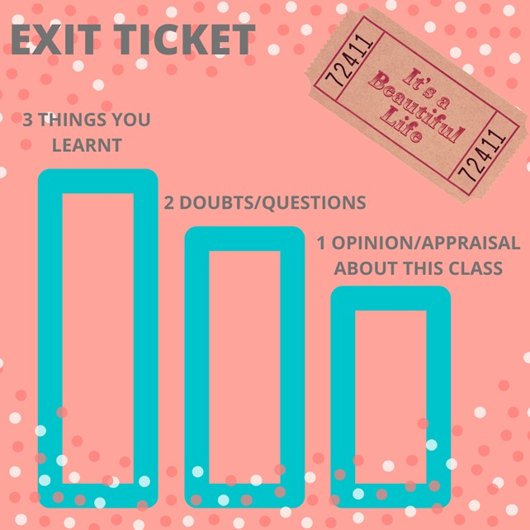
Final activity: Copy the following exit ticket in your copybook and answer.

