Slide 1
NEXT DOOR
Colegio Nuestra Señora María Inmaculada del Bosque
English Department
1st Grade
A story from another planet!

Slide 2
AIM
Students will be able to:
Read and understand chapter 7 from the book Next Door.
Identify key vocabulary and expressions from the book.
Identify and use structure from present simple and continuous.

Slide 3
CHAPTER 7
DAD TALKS TO THE RADIO

Slide 4
VOCABULARY
Subject
Adjective
Verb
Brilliant (brillante) : very good
Funny (divertido/a): makes laugh; strange.
Whole (todo/a): all
Seatbelt (cinturón de seguridad) : Safety belts in a car
Environment (medioambiente) : The world we live in
Defender: protector
Wars (guerras): when countries fight
Choice: Decision
Shout (gritar): Speak very loudly
Realizes (comprende): understand
Keep promises (mantener una promesa) : Do the thing I promise to do
Reading minds (leer mentes): knowing what a person thinks.
Concentrate (concentrarse): Give attention
Lie (mentir): Say something that is not true

Slide 5
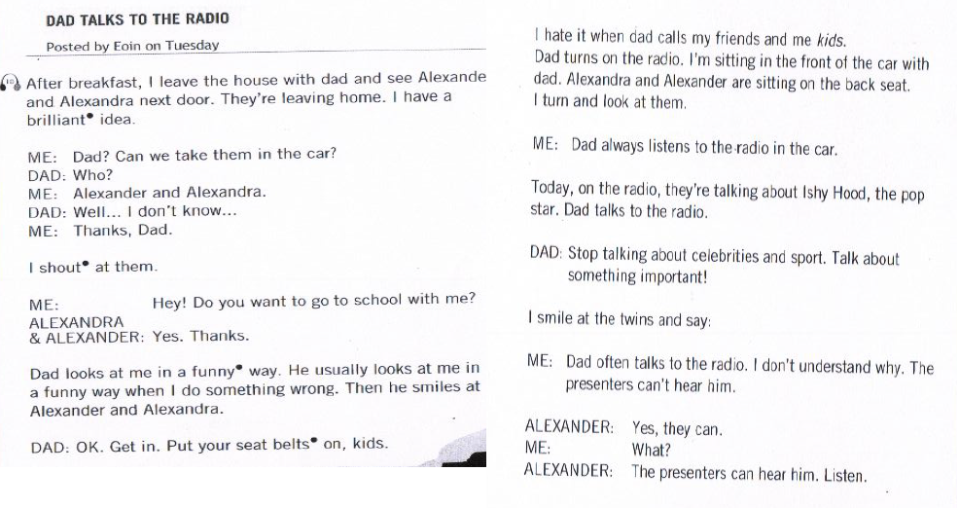
CHAPTER 7: Dad talks to the radio

Slide 6
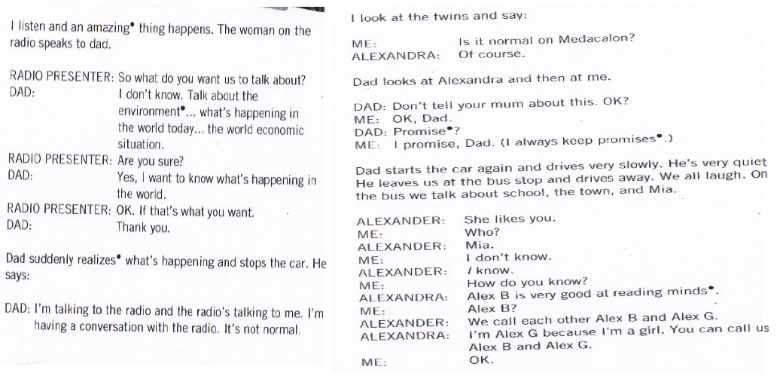

Slide 8
After reading: true or false
Are these statements true or false? Help me find out!
Alexander chooses Eoin for their sport team
“Alexander” means defender of the people
Mia doesn’t like Eoin
Eoin’s dad talks to the radio, but the radio doesn’t answer
Alexander can’t read minds
Students laugh when Eoin is chosen for a team

Slide 9
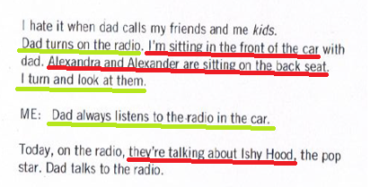
Now, let’s remember…
Can you identify the differences between the sentences underlined in red and the ones in green?

Slide 10
Now, let’s remember…
Simple
Present
Sentences in green are facts and habits
Present
Continuous
Sentences in red represent actions that are happening right now, in this moment.

Slide 11
Let’s do a short exercise… Match the definition to the correct tense
This tense is used to express actions happening in the moment
In this tense, you use –ing ending
In this tense, you use adverbs such as always, never, usually, sometimes and often
To form this tense, we have to use verb to be.
This tense is used to represent habits and routines
This tense is used with expressions like right now, in this moment, look!.
To form the 3rd person singular, we use –s, -es, -ies.
Simple
Present
Present
Continuous

Slide 12
Structures: sleep
Affirmative Negative Questions/Short Answers
Simple
Present
I sleep
She sleeps
We sleep
I don’t sleep
She doesn’t sleep
We don’t sleep
Do I / we sleep? - Does she sleep?
Yes, I / we do - Yes, she does
No, I / we don’t - No, she doesn’t
Am I sleeping?
Yes, I am
No, I’m not
I am sleeping
She is sleeping
We are sleeping
I’m not sleeping
She isn’t sleeping
We aren’t sleeping
Present
Continuous
Is she sleeping?
Yes, she is
No, she isn’t
Are we sleeping?
Yes, we are
No, we aren’t

Slide 13
ACTIVITY TIME

Slide 14
1. Complete the chart writing the correct version of each form of Simple present and Present continuous. Example: I am dreaming / I’m not dreaming / Am I dreaming?
Affirmative | Negative | Yes/No Question
Martin and his sister are watching “Dark”
 |  | Is Margarita telling the truth?
 | You don’t use the underground
I like the ocean
 |  | Are you writing a novel?
 | Alice is not dancing with a friend

Slide 15
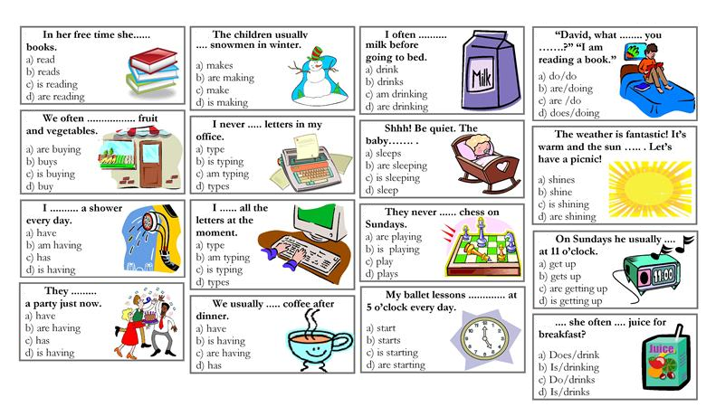
2. Complete the sentences. Choose the best alternative. Use either Simple present or Present Continuous.

Slide 16
3. Write a suitable sentence for each situation. Use Present Continuous
Example: It’s 9 pm. What is he doing? He is reading a book.
She is in her bedroom. What is she doing? ____________________________________
It’s 8 am in the morning. What are you doing? __________________________________
It’s your dad’s birthday. What is he doing now? _________________________________
A family arrives at the beach. What are they doing? ______________________________
My friends and I buy some food. What are we doing now? _________________________
The baby boy is hungry. What is he doing? _____________________________________
A camel gets thirsty. What is he doing now? ____________________________________
It’s 2 pm. What are your friends doing? ________________________________________

Slide 17
CHAPTER SIX: ANSWER KEY

Slide 18
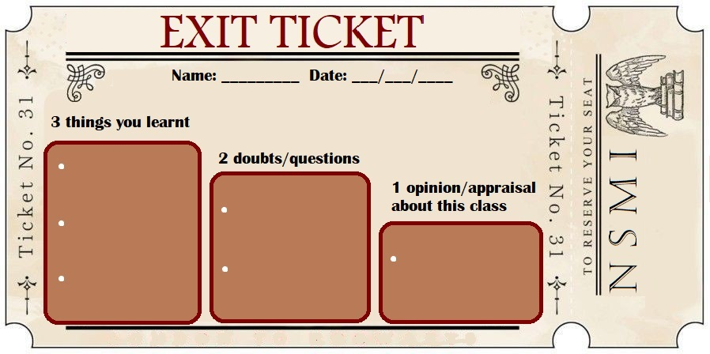
Complete the exit ticket in your copybooks

Slide 19
CONTENTS NEXT EVALUATION
SIMPLE PRESENT AND PRESENT CONTINUOUS
(affirmative, negative and questions)
Link formulario: https://docs.google.com/forms/d/e/1FAIpQLSfGfXwimV5n05RR38i7SzCqcneRQQQ_PP4G1rjs8O1qW_9c_w/viewform

Slide 20
THANKS!
Does anyone have any questions?
addyouremail@freepik.com
+91 620 421 838
yourcompany.com
DON’T FORGET TO FOLLOW US!
Youtube Channel for 1st grade students
https://www.youtube.com/channel/UCpZ9aYwKpOKDJRlZHSmuX2w/
NSMI English 1ero Medio
https://www.instagram.com/nsmi.english1ro.medio/

